Slide 1
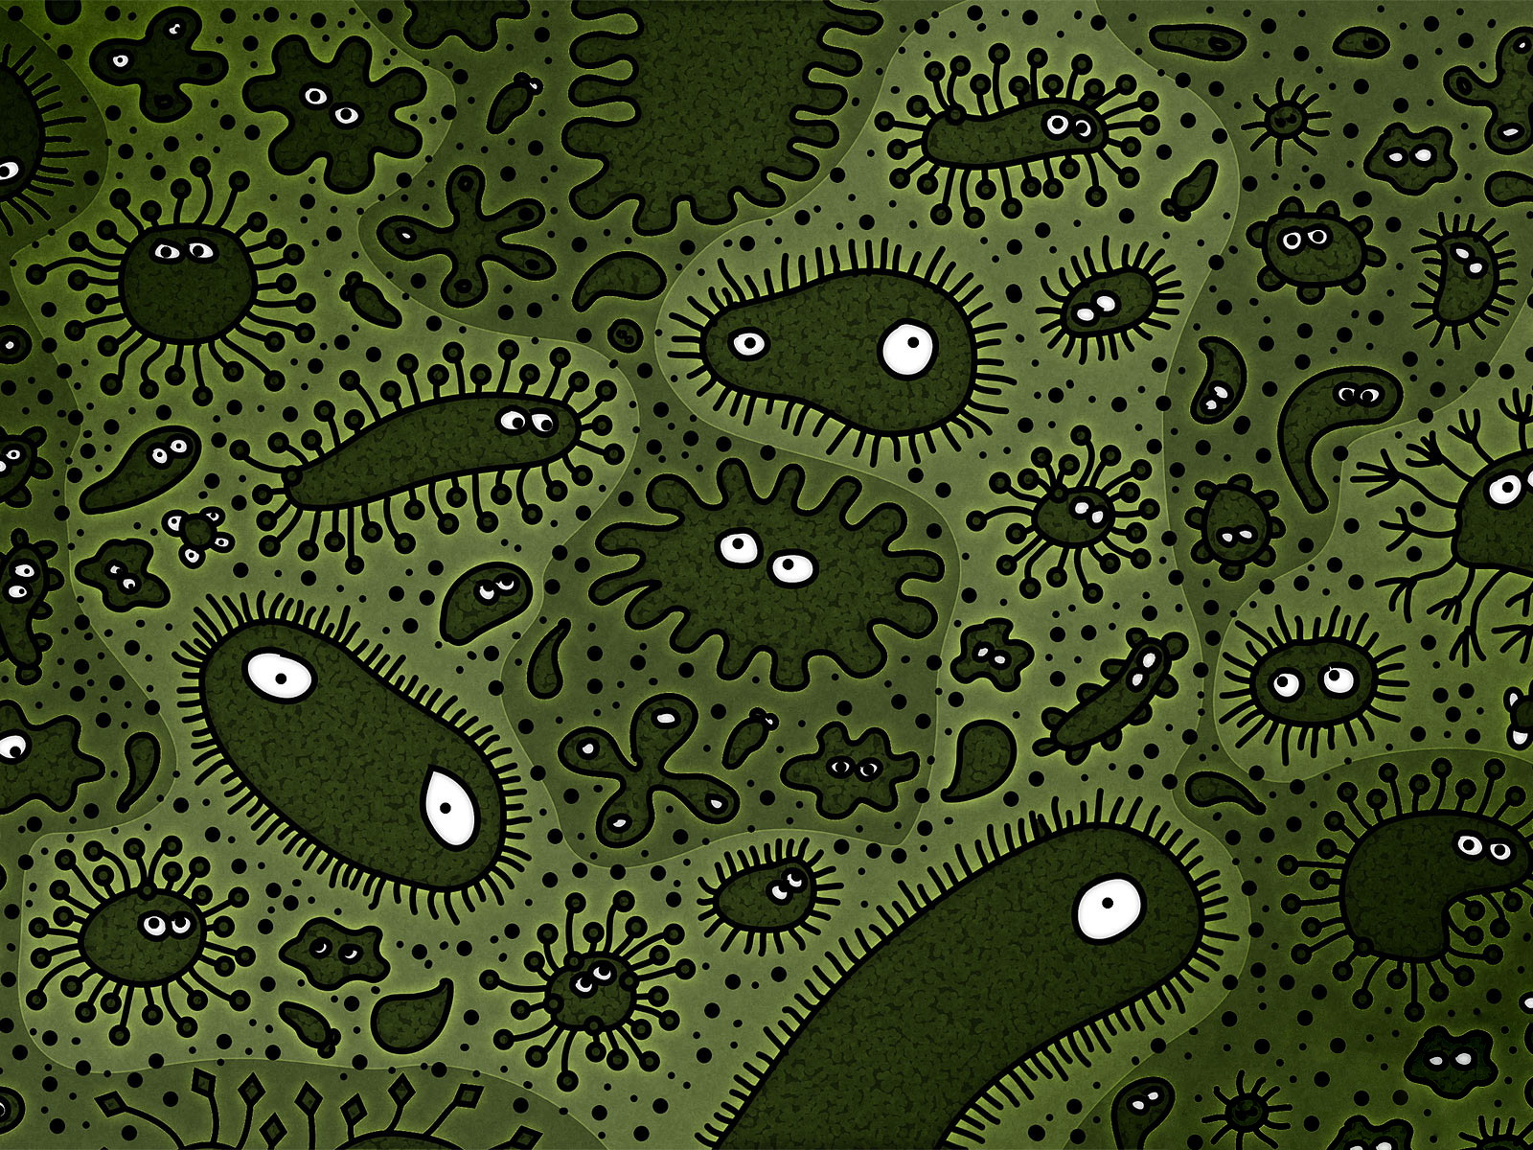
BIODEGRADABILITY OF POLYETHYLENE BY BREVIBACCILUS,PSEUDOMONAS, and RHODOCOCCUS SPP.

Slide 2
INTRODUCTION
Polyethylene is a polymer made of long chain monomers of ethylene. It is a thermoplastic commodity mostly used for packaging. Worldwide usage of polyethylene is increasing at the rate of 12% per annum. With such huge amounts of polyethylene getting accumulated in the environment, their disposal evokes a big ecological issue. It takes thousands years for their efficient degradation. Among the biological ways, microbial degradation is widely accepted and is still underway for its enhanced efficiency. The present research focuses on the biodegradation of polyethylene by Brevibaccilus, Pseudomonas, and Rhodococcus spp. By pure culture shake-flask incubation method.

Slide 3
MATERIALS AND METHODS
Isolation of polyethylene degrading bacteria
The soil sample was collected from a waste disposal site dumped with polyethylene bags and plastic products. The soil was analysed for its indigenous bacterial population responsible for biodegradation. Bacterial enumeration and isolation were performed.
Selective isolation of the three experimental bacteria i.e Brevibacillus, pseudomonas and Rhodococcus spp. was achieved and the isolates were obtained in pure culture to be used as the inoculum in degrading polyethylene. The cultures were maintained at ambient temperature and frequently revived to sustain their viability profile.

Slide 4
PRE-TREATMENT OF POLYETHYLENE
General grade of polyethylene employed for commercial grocery carriage purpose was used to investigate its biodegradability nature. The polyethylene was cut in small & fine species, washed with ethanol(to remove any organic matter adhering to the surface), distilled water & air dried. The pieces were crushed by grinding in a mortar pestle along with sufficient amount of crystalline NaCl till they get minced in form of fine ruptured threads. The mixture was transferred into a conical flask with distilled water & mixed well in a shaker for 1 hour. Crystalline NaCl was chosen for the purpose because the crystals would help in easy grinding & rupturing the polyethylene and its solution would wash away all impurities & organic matter adhering to it. The solution was passed through a Whatman no.41 filter paper Polyethylene particles were recovered from over the filter paper gently & air dried.

Slide 5
TREATMENT OF POLYETHYLENE
The isolated Brevibacillus, pseudomonas and rhodococcus spp. were individually inoculated in 100ml of nutrient broth in respective conical flask except the control. 0.2 g of polyethylene was amended to each flask except the blank. The following were the experimental designs for treatments: T1( polyethylene+brevibacillus ),T2 (polyethylene+pseudomonas ), and T3 (polyethylene +rhodococcus). All treatments were incubated in a incubator shaker at 150rpm for 3 weeks but due to variation in growth temperatures, T1 was incubated at 50 C where as T2 and T3 at 40 C, respectively. The analyses were conducted in triplicates with a control and blank for each treatment. Blanks were used to examine the viability of the bacteria.

Slide 6
DRY WEIGHT DETERMINATION OF RECOVERED POLYETHYLENE
The residual polyethylene particles were recovered from the broth cultures by passing through a course filter paper. The bacterial biofilm adhering to the polyethylene surface was washed by a 2%(v/v) aqueous sodium dodecyl sulphate solution for 2 to 3 Hours and finally distilled with water. The washed polyethylene particles were air dried and weighed. The dry weights of recovered polyethylene particles from the culture media were taken in weekly intervals (i.e day 0, day 7, day 14 and day 21) for accounting the rate of degradation.

Slide 7
RESULTS AND DISCUSSION
After incubation, the culture flasks were removed from the incubator shaker and tested for viability of micro organisms and any contamination in the medium. The test results indicated a good stability of the three bacteria in the medium with no sign of contamination. Biofilm formed by three bacteria was clearly visible in the broth cultures and that of pseudomonas was to viscous and slimy.

Slide 8
COMPARITIVE ANALYSIS OF POLYETHYLENE WEIGHTS IN DIFFERENT TREATMENTS BEFORE AND AFTER INCUBATION
Treatment | Weight of PE(initial)(g) | Weight of PE (final)(g) | Weight of PE degraded (g) | Weight of PE degraded (g)

Slide 9
TRENDS OF POLYETHYLENE DEGRADATION IN DIFFERENT TREATMENTS

Slide 10
Bio degradation depends upon polymer characteristics, organism type and nature of pre-treatment. The pre-treatment of polythene is very significant for its biodegradation. Physical rupturing of the polythene and chemical washing by ethanol might have added value to its degradability. To support this volke-sepulveda et al.(2002) showed that addition of ethanol to fungal cultures containing polyethylene improved the biodegradation rate of polymer. This gives us clue that these bacteria can be used in both natural and artificial conditions for the purpose of degradation of polymers.

Slide 11
REFERENCES
El-shafei HA, El-Naseer NHA, Kansih AL, Ali AM. Biodegradation of disposable polyethylene by fungi and streptomyces species. Polymer degradation and stability 1998;62:361-365.
Gu JD, Ford TE, Mitton DB, Mitchell R.Microbial corrosion of metals. The Uhlig Corrosion Handbook. 2nd edition. Wiley, New york, USA 2000:915-927
Jang J-C, Shin P-K, Yoon J-S, Lee I-M, Lee H-S, Kim M-N. Glucose effects on the biodegradation of plastic by compost from food garbage. Polymer degradation and stability 2002;76:155-159

Slide 12
